Slide 1
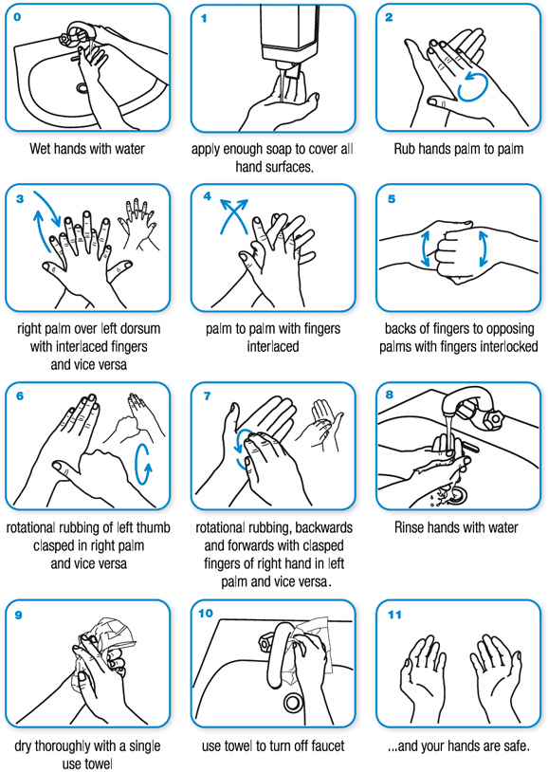
How do I wash my hands properly?
“Keeping hands clean is one of the best ways to prevent the spread of infection and illness”
Handwashing is easy to do and it's one of the most effective ways to prevent the spread of many types of infection and illness in all settings—from your home and workplace to child care facilities and hospitals

